Slide 1

Vital Health
Marketing Insights & Recommendations
Campaign Performance
Sylvia YanWen Tsai- Data Team

Slide 2

Table of Contents
Project Overview
North Star Metrics
Insights Deep-Dive
Recommendations and Next Steps
Appendix
Vital Health

Slide 3
Overview

Slide 4
Context
The goal of this project is to investigate the performance of marketing campaigns at Row Health in order to surface recommendations on marketing budget allocation for 2024 campaigns.
The budget is allocated to drive two primary objectives: 1) to increase the number of customer signups, and 2) to raise awareness of Row Health’s brand across the country.
Vital Health

Slide 5
North Star Metrics
In order to evaluate campaign performance, we focused on the following key metrics:
Increase Signups
Increase Awareness
Signup Rate
The percent of people who see a campaign and subsequently sign up for a Row Health plan.
Click Through Rate
The percent of people who see a campaign and click on the associated link.
Cost per Signup
The average dollars spent in order to acquire a signup from each campaign.
Vital Health

Slide 6
North Star Metrics
Compared to industry benchmarks, Row Health has low signup rate and low CPC, but higher than average CTR.
Increase Signups
Increase Awareness
Signup Rate
From 2019 to 2023, the average signup rate was 0.2% across 16.3K total signups.
Click Through Rate
From 2019 to 2023, the average click through rate was 9.5% across 8.4M impressions.
Cost per Signup
From 2019 to 2023, the average cost per signup was $2.2, ranging from $0.6 to $124 per campaign.
Vital Health

Slide 7
Insights Deep-Dive

Slide 8
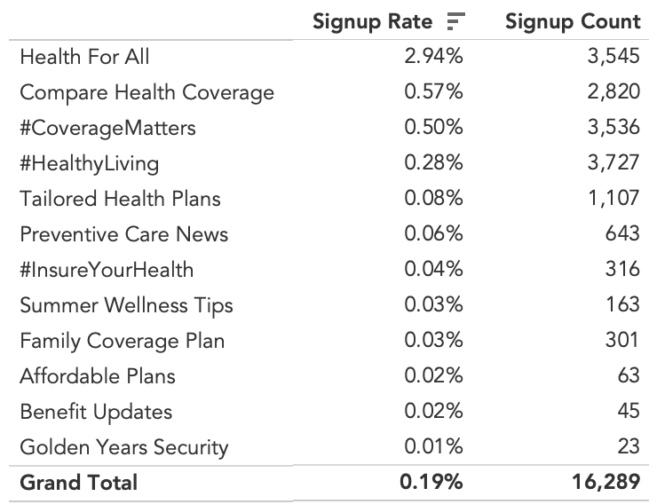
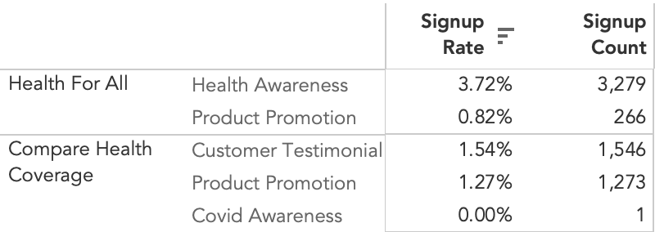
Signup rate was by far the highest among Health For All campaigns.
Across campaign categories, Health for All campaigns had the best-performing signup rate (2.9%) and the second-highest number of signups (3.5K).
This high signup rate is due to the Health Awareness campaign type, which had by far the highest signup rate across all campaign types (3.72%).
Interestingly, the category with the highest number of signups - #HealthyLiving - had a comparably low signup rate at 0.3%.
Vital Health

Slide 9
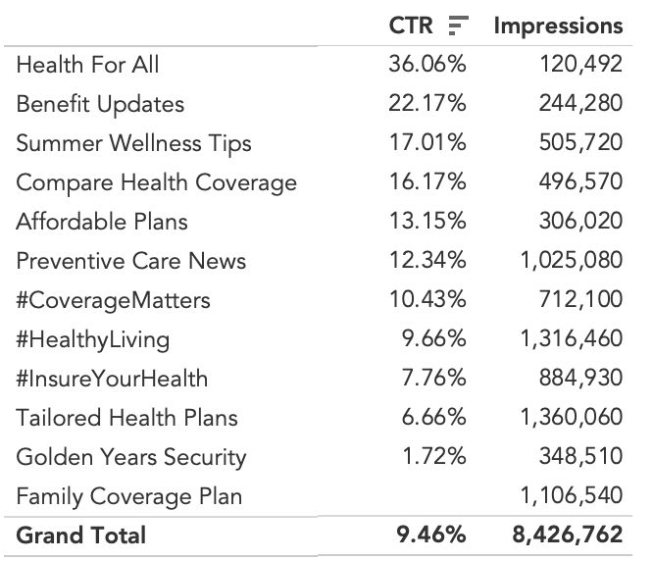
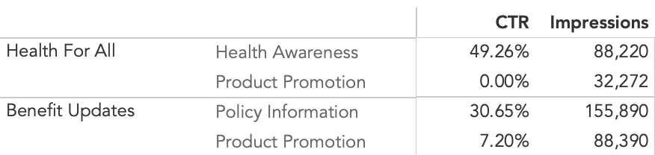
Health for All campaigns also outperformed on CTR compared to campaigns with more impressions.
Across categories, Health for All and Benefit Updates performed nearly 3-4x better than the average CTR at 36% and 22%, respectively.
Within the two categories with high CTR, product promotion-based campaigns had relatively low CTR (0% and 7%).
Family Coverage Plan had high impressions but no clicks - this needs to be investigated and could be due to missing data or issues with the campaign.
Vital Health

Slide 10
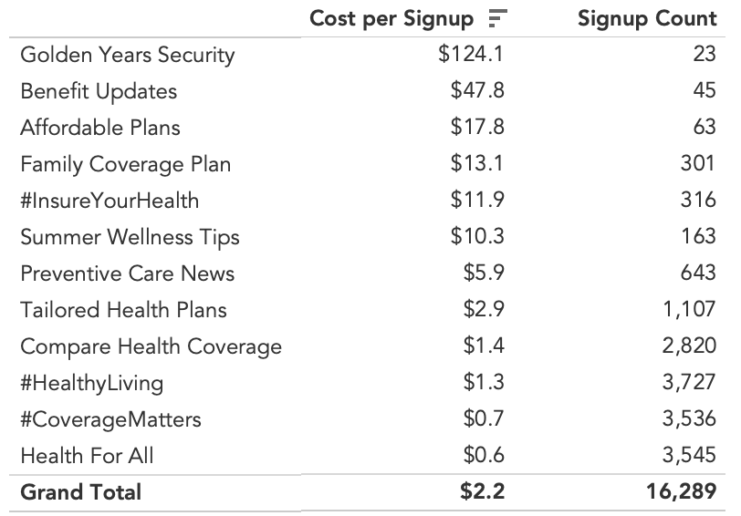
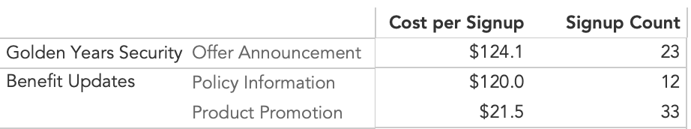
Cost per signup was high for Golden Years Security, which performed poorly in terms of cost and volume.
Across campaign categories, Golden Years Security had by far the highest cost per signup ($124), as well as the lowest number of signups (23), compared to an average of $2.2.
Within the two campaign categories with highest cost per signup, info-based campaign types (like offers and policy info) drove high costs per signup.
Some COVID-based campaigns also had abnormally high CACs at $1.2-$1.3K.
More on this in the Appendix section.
Vital Health

Slide 11
Recommendations and Next Steps

Slide 12
Key Recommendations
Increase Signups and Awareness
Health for All: Reallocate budget from Golden Years Security, which has high cost per acquisition, to Health for All campaigns. The second category outperforms across all key metrics, yet we have invested a relatively low amount ($20K) on them.
Health Awareness: Within Health for All campaigns, focus on health awareness-type marketing, and less on product promotion-type campaigns, which had low signup rate and CTR.
COVID Campaigns: Investigate the cause of abnormally high cost per signup for COVID-based campaigns, which had 2 signups that costed over $1K, compared to an average signup cost of $2.2. Consider removing these campaigns altogether.
#HealthyLiving: Decrease investment in this campaign category, which has the highest spend ($46K) but mediocre signup rates compared to Health for All campaigns.
Recommendations focus on two strategies: removing ineffective campaign categories and reallocating budget towards categories with better performance across north star metrics.
Vital Health

Slide 13
Caveats and Next Steps
For improved analysis and future steps, consider the following:
Improved data quality & availability | Include campaign start and end dates to understand campaign performance over time Investigate missing clicks for Family Coverage Plan category
Include other dimensions | Include customer-specific dimensions (plan, state) to further tailor campaign recommendations based on client demographics Explore relationship between campaigns and customer claims to identify and target ideal patient types
Revisit marketing budget with team | Regroup with marketing team to explore the potential impact of recommendations Explore Tableau Dashboard for more insights and recommendations tailored to campaign categories and types
Vital Health

Slide 14
Thank you!

Slide 15
Appendix

Slide 16
Technical Process
Dataset stats:
33 unique campaigns were analyzed across 12 different campaign types
16,338 customers were attributed to campaigns
Data ranges from 2019 to 2023
Data points involved:
Campaigns: campaign category, campaign type, clicks, cost, impressions (33 total records)
Customers: customer name, plan, signup date, and state (16,338 total records)
The technical process included:
Loading data into Tableau from Excel
Building a self-service dashboard for visualization in Tableau
Use calculated functions to calculate CTR, CPC, and signup rate
Use filters to alternate views based on plan, state, and campaign type
Minimal data cleaning was needed for this dataset, but could involve: checking for nulls and nonsensical values, aligning date types, and augmenting missing data
Vital Health

Slide 17
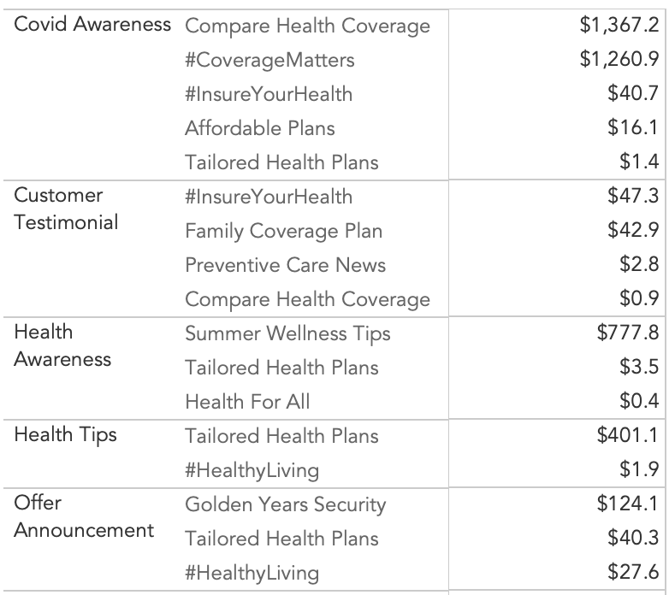
Supplementary Data - CAC (Covid Campaigns)
High Cost per Signup for Covid Type Campaigns
Vital Health

Slide 18
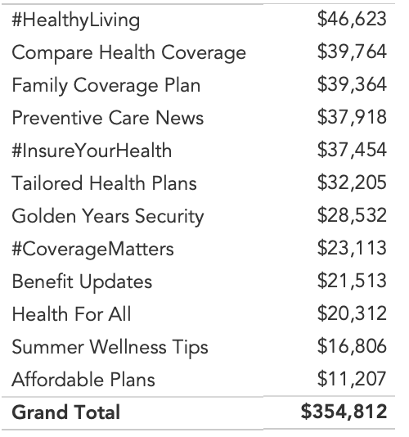
Supplementary Data - Spend by Category
Campaign Category Spend (2019-2023)
Vital Health

